Slide 1
System Analysis and project management
Notes:
Have any of you ever have to circle a block multiple times just to find a parking space while checking out the latest trending restaurant or while going clubbing/partying with friends? Our project, Park In, is a platform aimed at solving urban parking challenges by connecting drivers with parking spaces in real time. It simplifies the parking process for drivers while creating new income opportunities for parking space owners.

Slide 2
Tables of contents
Problem Statement
Objective
Scope
Key Features of the Platform
Prospective Features
Work Break-Down Structure
System Context Diagram
Software Design
Process Modelling Diagram
Sequence Diagram
Activity Diagram
Use-Case Diagram
Class Diagram
Entity Relationship Diagram
Data Flow Diagram
Database Design
Interface Design
Notes:
Our project, Park In, is a platform aimed at solving urban parking challenges by connecting drivers with parking spaces in real time. It simplifies the parking process for drivers while creating new income opportunities for parking space owners.

Slide 3

PROBLEM STATEMENT
Difficulty in finding parking spaces causes inconvenience and traffic congestion, while property owners struggle to monetize surplus parking.
A solution is needed to improve parking space discovery and maximize revenue from unused spots.
Notes:
Finding parking is time-consuming and contributes to traffic congestion. Meanwhile, parking space owners often leave valuable spaces underutilized. A comprehensive solution is needed to bridge this gap, optimizing both convenience and revenue generation.

Slide 4
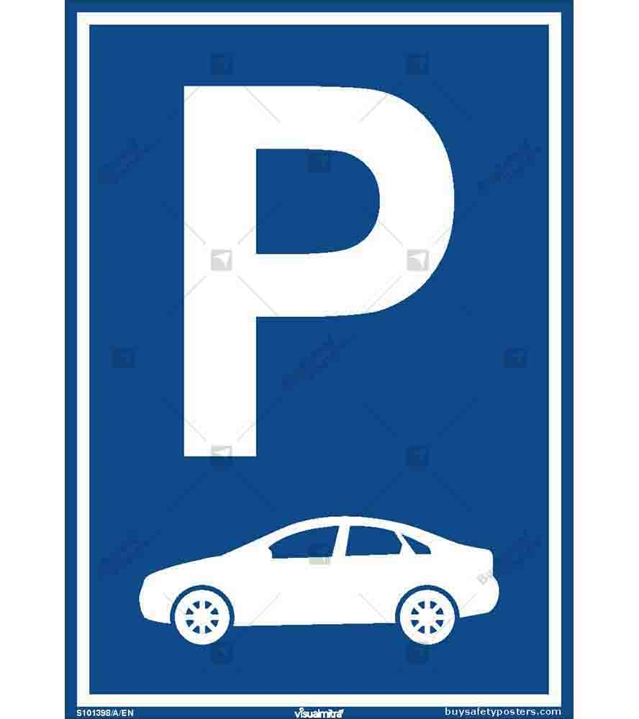
OBJECTIVE
The primary aim is to develop a comprehensive platform designed to revolutionize the way parking spaces are rented.
Notes:
Our primary objective is to develop a digital marketplace that seamlessly connects drivers with available parking spaces in real time, reducing traffic congestion and enabling property owners to monetize unused spots.

Slide 5
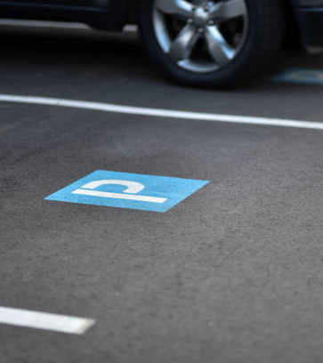
scope
In Scope:
Developing a user-friendly digital marketplace for listing, booking, and paying for parking spaces.
Real-time updates on parking availability integrated with location services.
Secure payment gateways supporting both short- and long-term parking needs.
Advanced features like dynamic pricing, a rating system, and multi-location support.
Mobile app access for seamless use, with offline functionality for pre-downloaded updates.
Notes:
In Scope:
Developing a user-friendly digital marketplace for listing, booking, and paying for parking spaces.
Real-time updates on parking availability integrated with location services.
Secure payment gateways supporting both short- and long-term agreements.
Advanced features like dynamic pricing, a rating system, and multi-location support.
Mobile app access for seamless use, with offline functionality for pre-downloaded updates.
Out of Scope:
Physical hardware installations for parking management (e.g., barriers or sensors).
Direct involvement in resolving disputes between parking owners and users.
Services like valet parking or maintenance of listed parking spaces.
Custom solutions for non-standard parking spaces requiring special arrangements.

Slide 6
scope
Out of Scope:
Physical hardware installations for parking management (e.g., barriers or sensors).
Direct involvement in resolving disputes between parking owners and users.
Services like valet parking or maintenance of listed parking spaces.
Custom solutions for non-standard parking spaces requiring special arrangements.
Notes:
Out of Scope:
Physical hardware installations for parking management (e.g., barriers or sensors).
Direct involvement in resolving disputes between parking owners and users.
Services like valet parking or maintenance of listed parking spaces.
Custom solutions for non-standard parking spaces requiring special arrangements.

Slide 7

KEY FEATURES
1. User-Friendly Interface
2. Advanced Booking System
3. Secure Payment Gateway
4. Rating and Review System
5. Dynamic Pricing Option
6. Support for Multiple Locations

Slide 8
PROSPECTIVE FEATURES
The system will be accessed mainly through a downloadable app. This app will use an internet connection to give real-time updates on the user's location. Users who expect to travel to areas with limited or no internet access can pre-download the most recent reports for those regions.

Slide 9
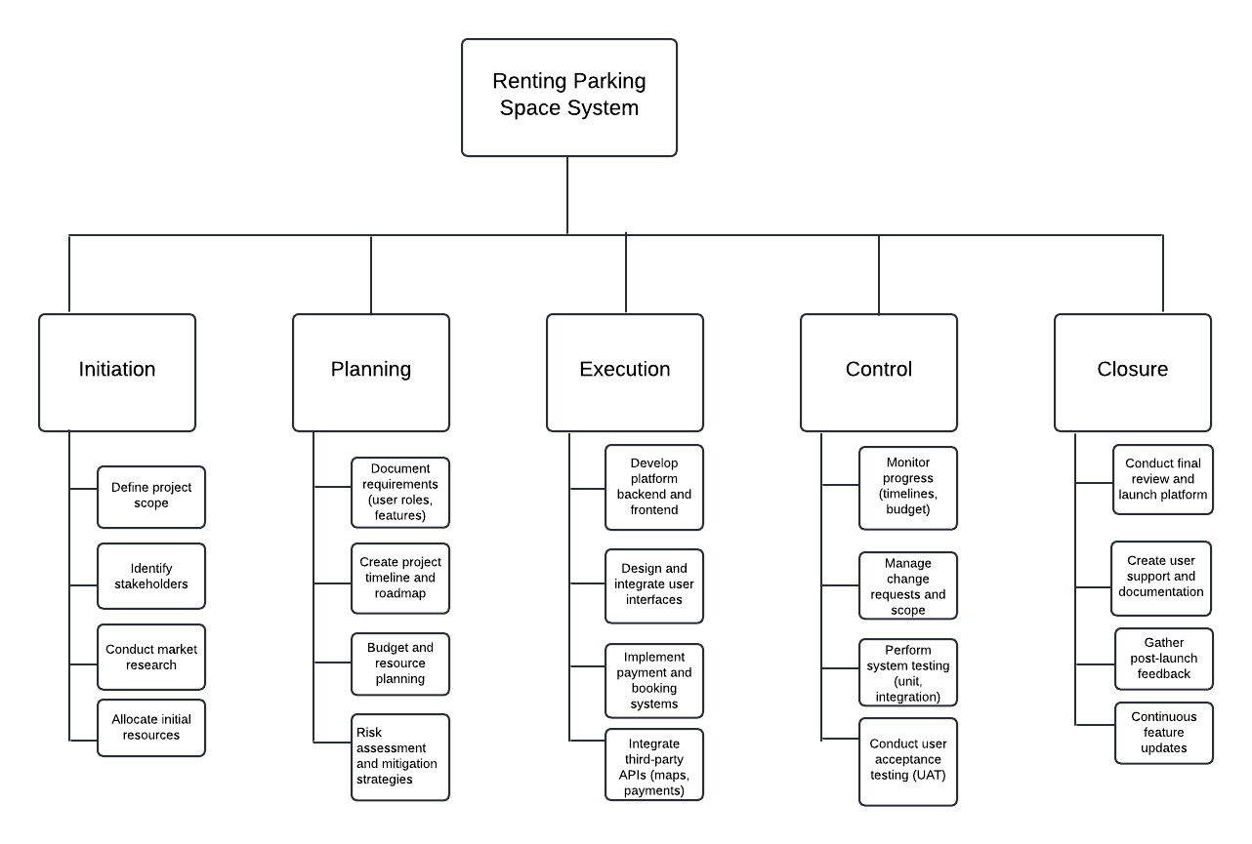
Work break down structure

Slide 10
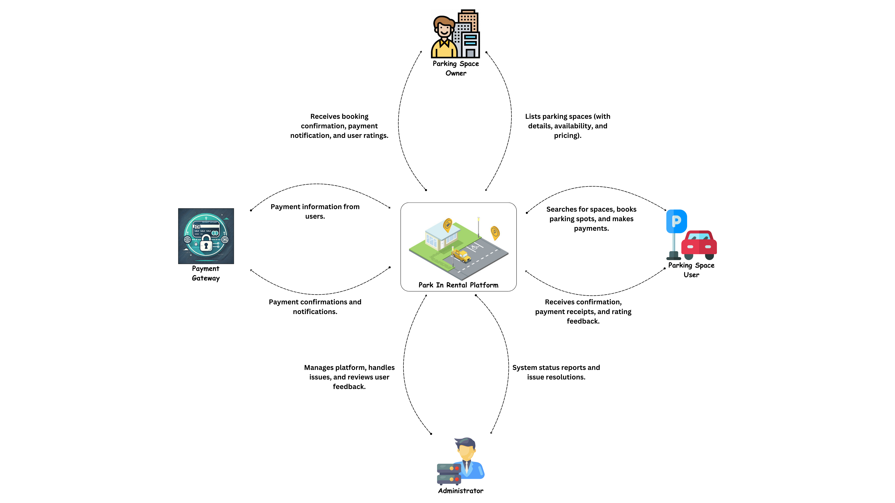
System CONTEXT diagram

Slide 11
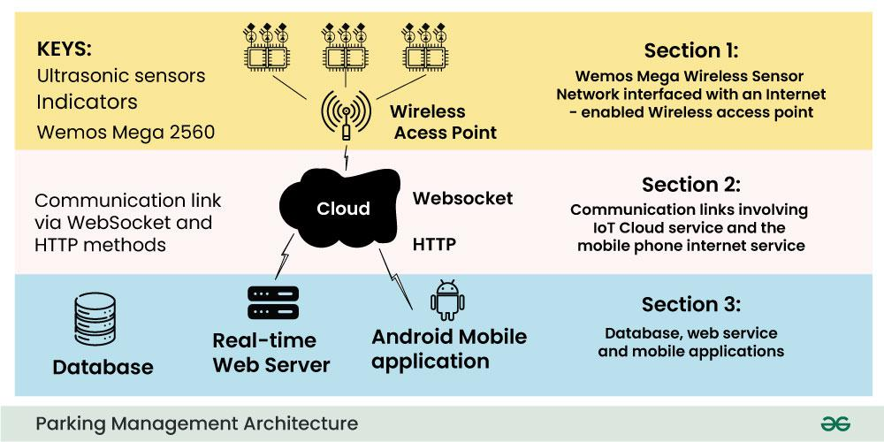
SOFTWARE DESIGN

Slide 12
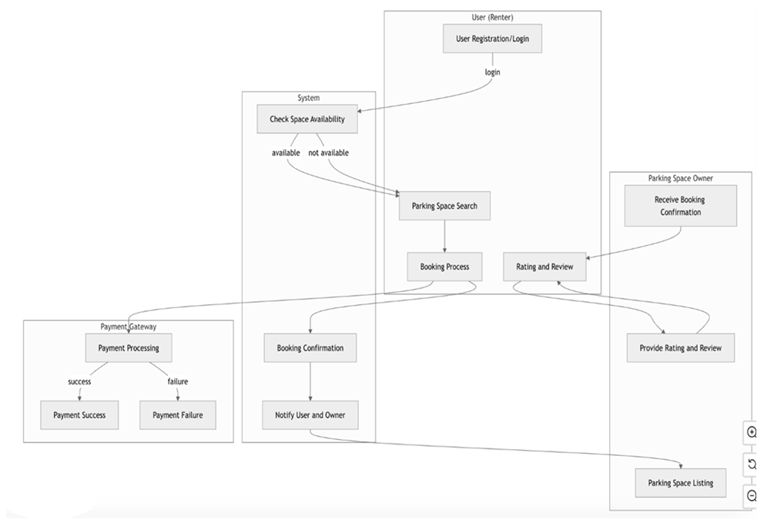
Process Modeling Diagram
Notes:
steps involved in a process from start to finish, Improves communication and understanding of complex processes . This is explanign to what will happen within each phase of the system when an action takes places

Slide 13
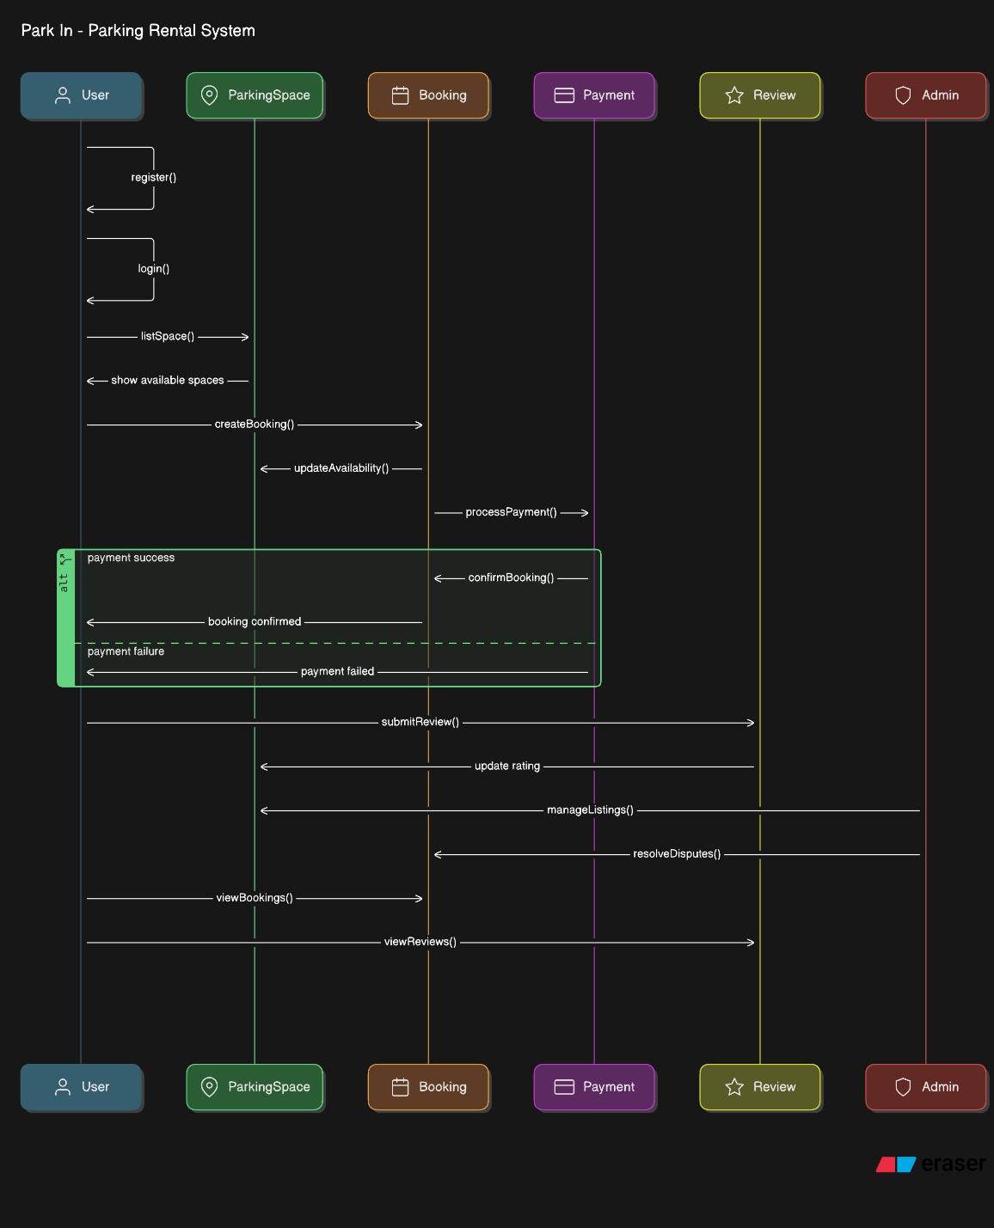
Sequence Diagram -
Notes:
When a process is taking place how the interaction would take place with in the object with a a system epicts the interactions between objects within a system

Slide 14
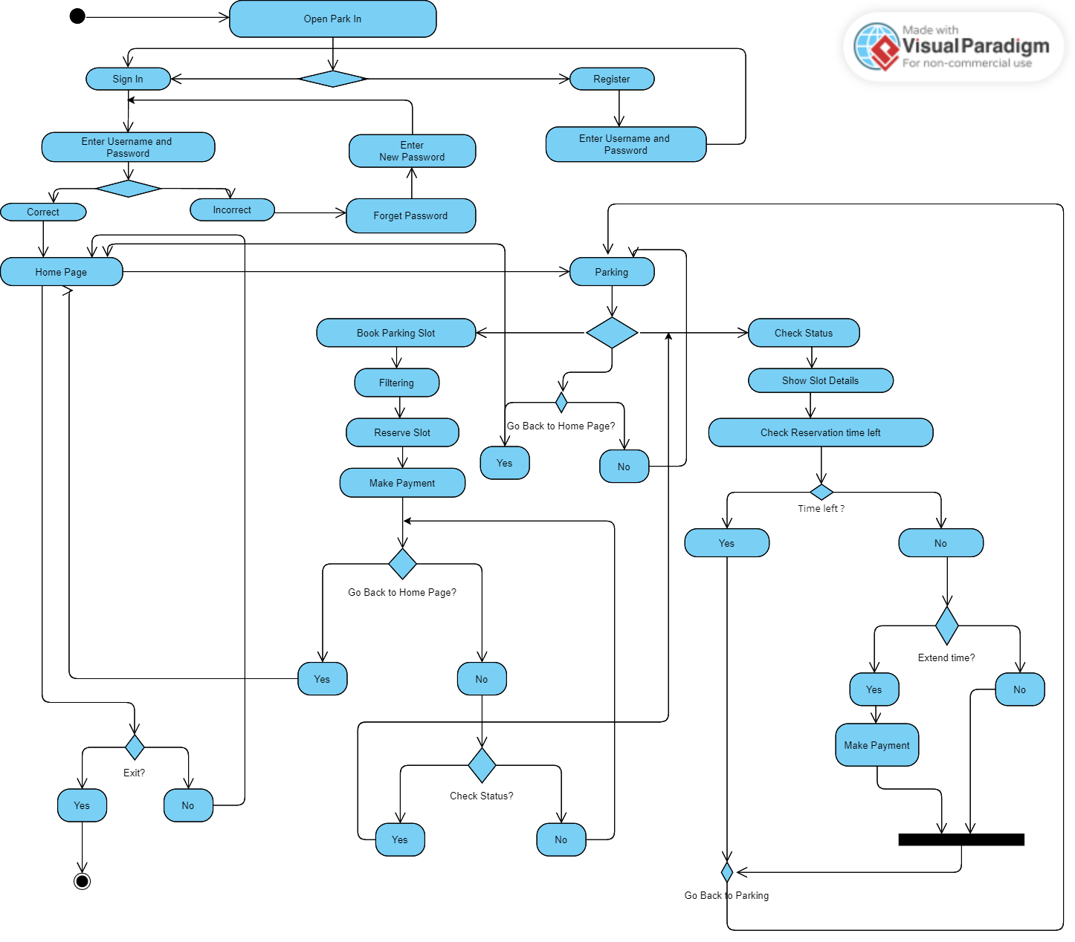
Activity diagram
Notes:
flow of activities within a system or process, showing how different actions are connected and can occur sequentially, concurrently, or with decision points
Activity nodes: Represent individual actions or steps in the process 1, 2, 5].
Control flow arrows: Indicate the direction of flow between activities 1, 5, 6].
Decision points (diamonds): Represent choices or conditions where the flow[ can diverge based on a decision.
Fork and Join points: Used to model parallel activities where multiple actions can occur simultaneously [1.
Initial and Final nodes: Mark the start and end points of the activity 1, 6, 9].

Slide 15
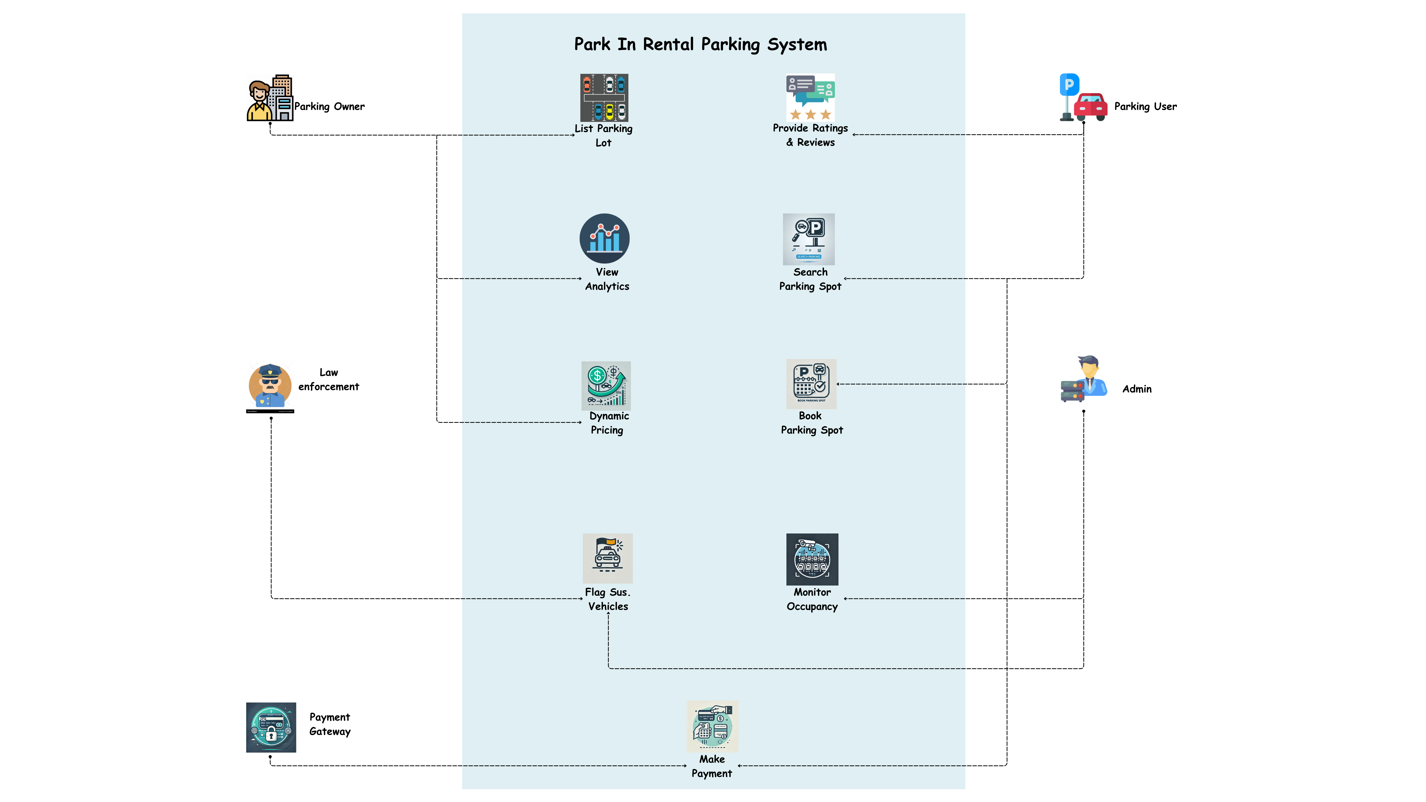
Use-case diagram
Notes:
Defining system requirement and Identifying goals – this is drawn from perspectives of 4 different users

Slide 16
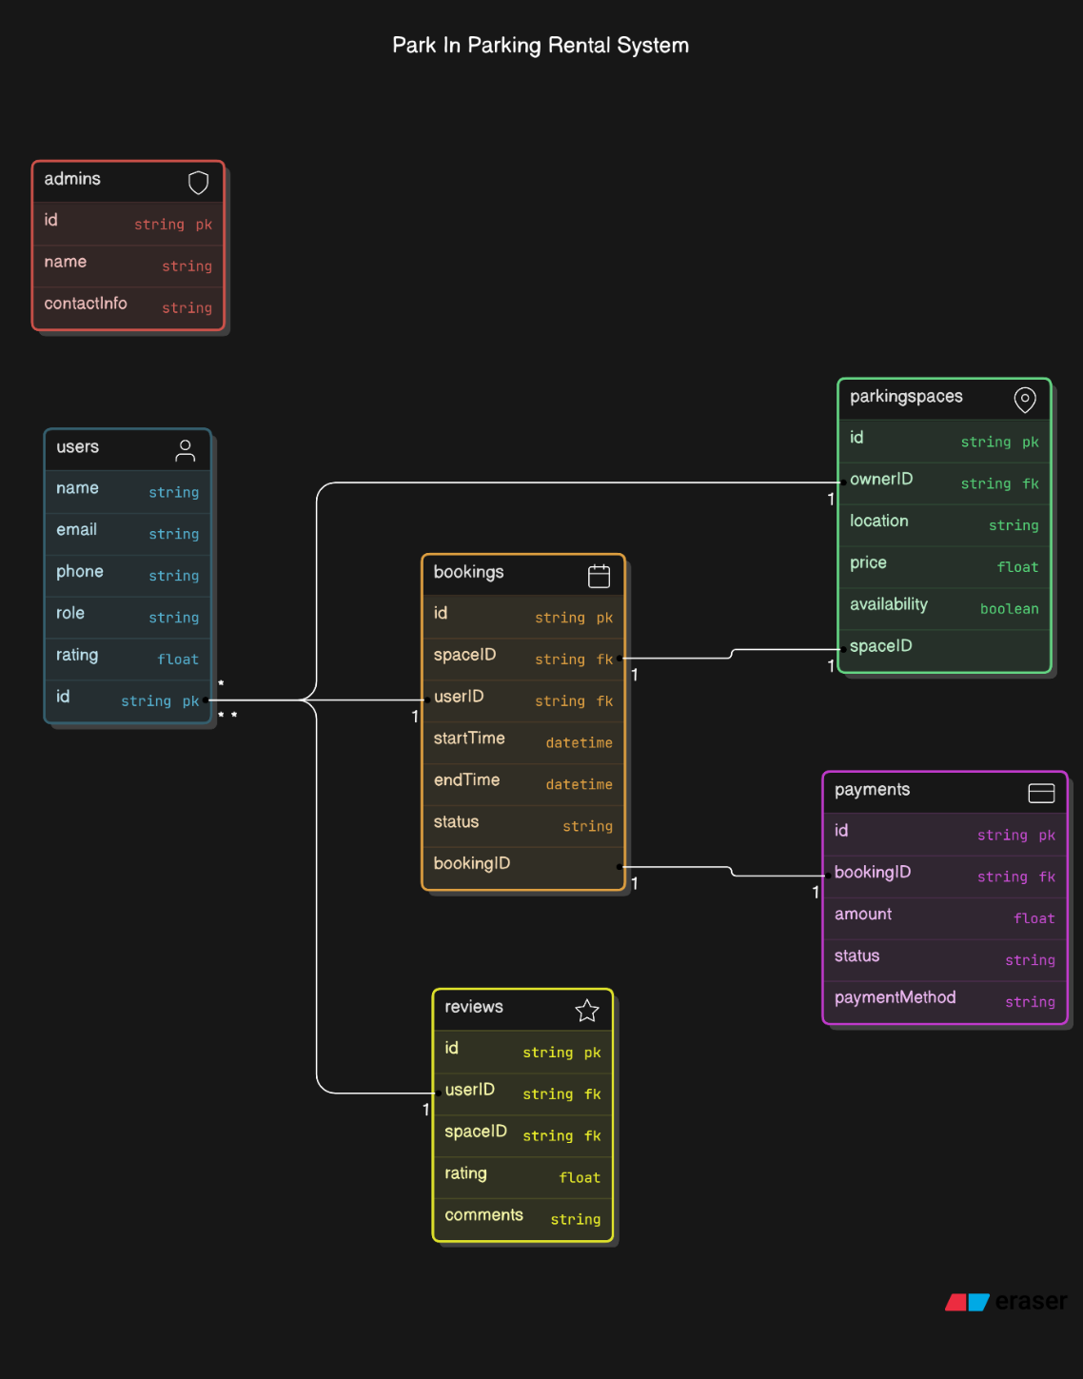
Class Diagram:
Notes:
type of static structure diagram that describes the structure of a system.

Slide 17
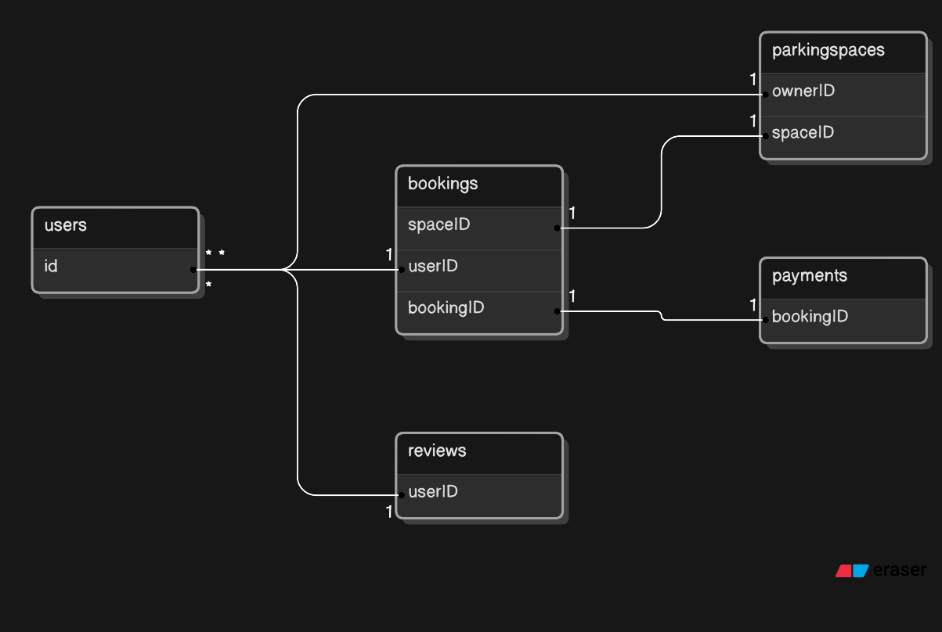
Entity Relationship Diagram
Notes:
How the tables are interacting and type of multiplicity they are having with other tables The highlighted columns are the primary keys of the tables

Slide 18
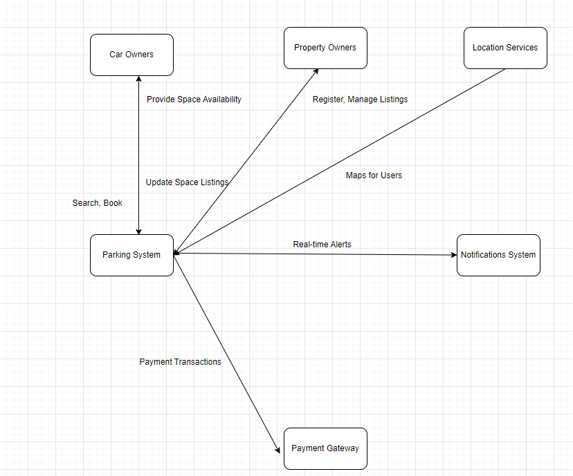
DATA-FLOW Diagram
Notes:
Once a process has taken place from the user’s end – the data flow is depicting how the data is expected to flow within the system . This helped us in setting up the referential intergretify for the system

Slide 19
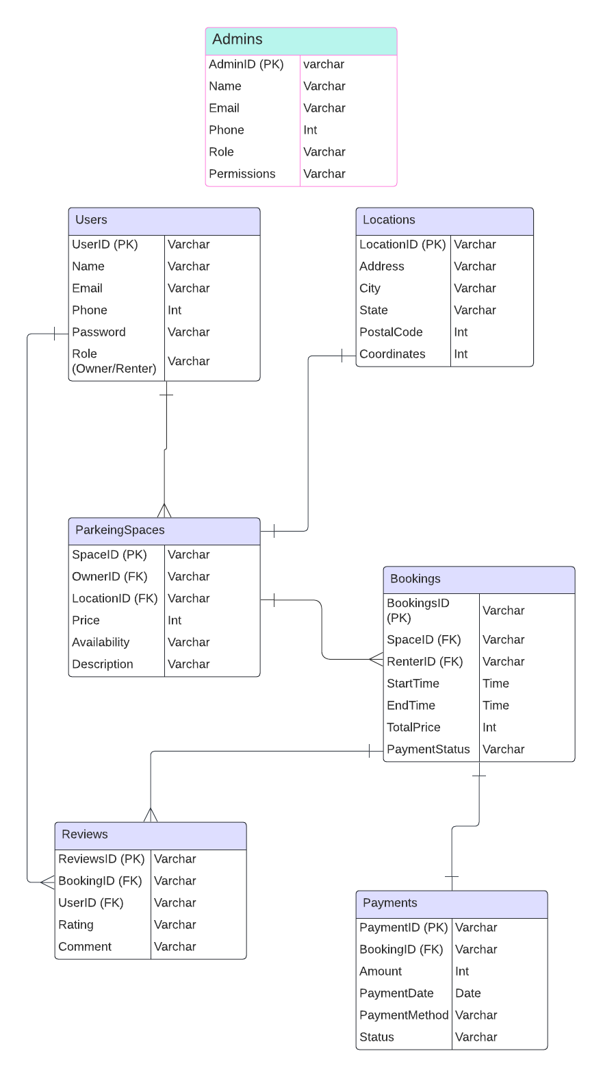
Database design
Notes:
Table interaction and its relationship within the system

Slide 20
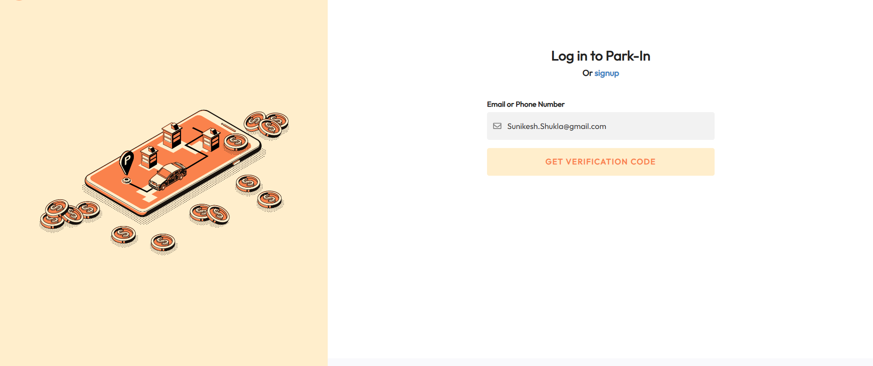
Interface design:

Slide 21
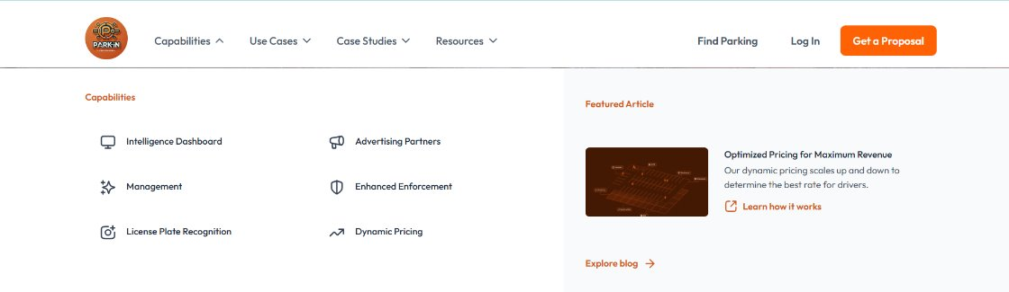
Interface design:

Slide 22

Thank you

